Slide 1
Convention on the Rights of Persons with Disabilities –
How We Got It, How We Got There, Where We’re Going From Here
Tina Minkowitz
Center for the Human Rights
of
Users and Survivors of Psychiatry

Slide 2
CRPD – What is it?
Convention on the Rights of Persons with Disabilities
Human rights treaty
International law
U.S. has signed but not ratified – must not undermine but not yet legally bound
119 countries have ratified, including Canada and almost all Latin America

Slide 3
International Law and
Human Rights
CRPD came from the grass roots and from governments
Our movement started out being “for human rights and against psychiatric oppression”
Historic documents
  10th International Conference Principles 1982
  NCD From Privileges to Rights 2000
  WNUSP Human Rights Position Paper 2001

Slide 4
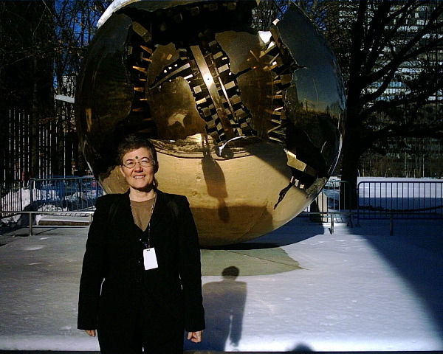
At UN: the Cracked Globe

Slide 5
WNUSP Principles for First Meeting
1) We speak for ourselves and reject anybody else's attempt to speak for us.
2) The MI principles have to be overruled.
3) Psychiatric disability should not be singled out.
4) Our core issues are no incarceration, no forced intervention in the name of treatment, full legal and human rights with no discrimination, no contingent services.

Slide 6
Why these Core Issues?
No incarceration – If they have us locked up, they can do anything including forced drugging, restraint, electroshock etc.
No forced intervention in the name of treatment – Forced drugging, etc. are acts of violence – “if it’s force, it’s not treatment”

Slide 7
Why these Core Issues? 2
Full legal and human rights with no discrimination – No guardianship, representative payee, other legal inferiority – No discrimination in work, housing etc.
No contingent services – Housing is a human right, health care is a human right – these rights belong to the individual and you can’t be made to choose between one right and another (such as privacy, or refusing unwanted treatment)

Slide 8
The Process
Pre-1st meeting in Mexico City
1st and 2nd meetings – deciding to create a treaty – accepting proposals of “elements”
Working Group January 2004 – making a single draft text
3rd and 4th meetings – commenting on text
5th, 6th, 7th and 8th meetings – negotiating to final version
December 2006 – cleaning up the text, adoption by UN General Assembly
May 2007 open for signature, 2008 entry into force

Slide 9
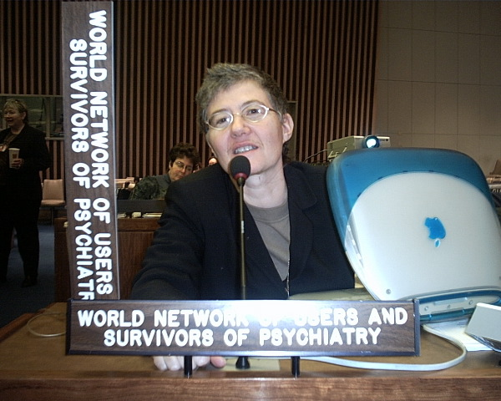
Writing the Convention
Photos by Diana Signe Kline

Slide 10
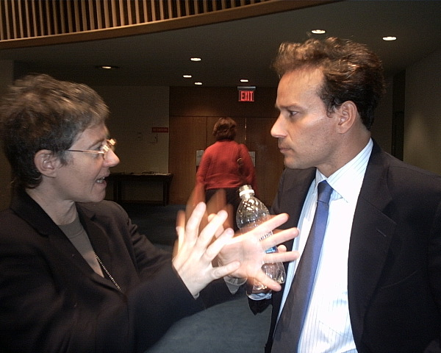

Slide 11
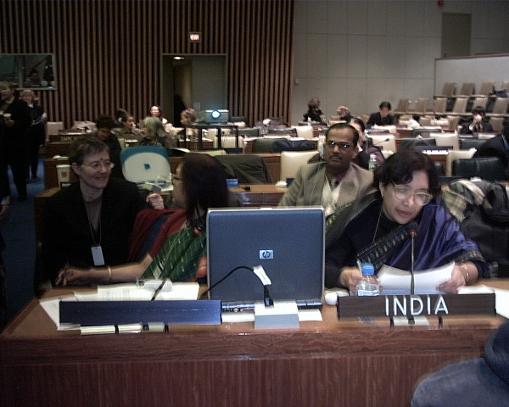

Slide 12
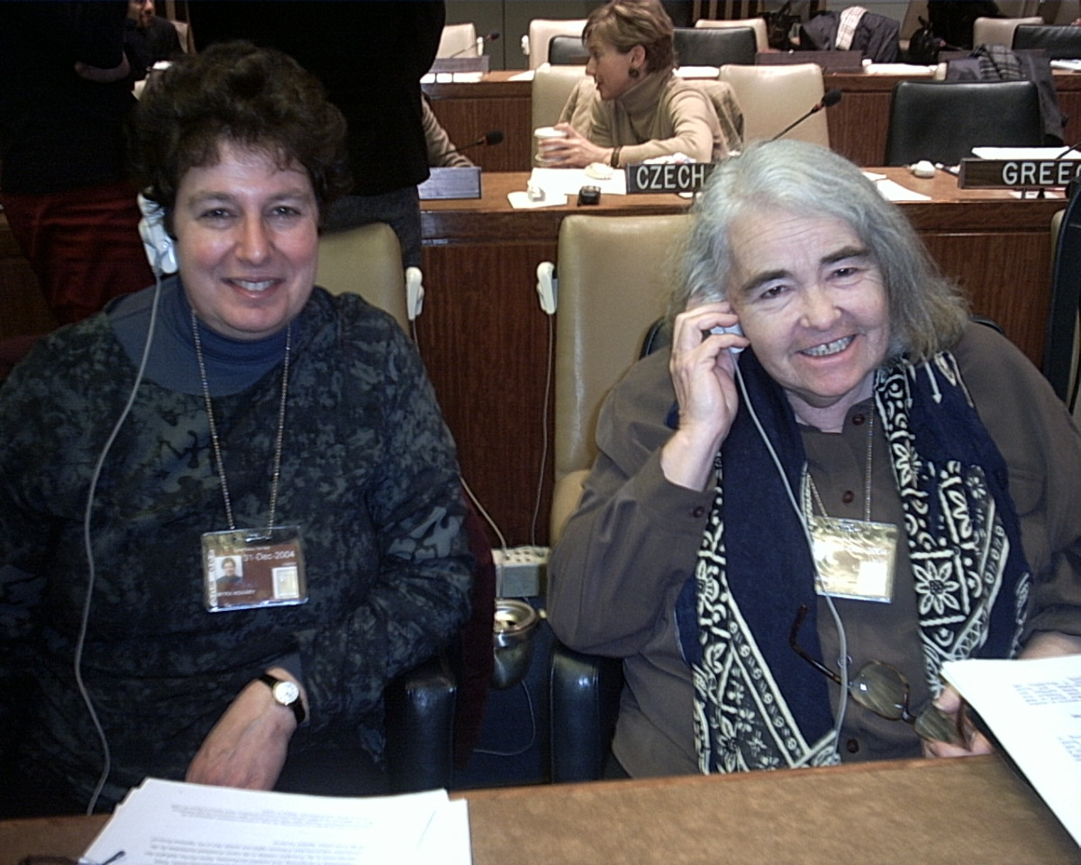

Slide 13
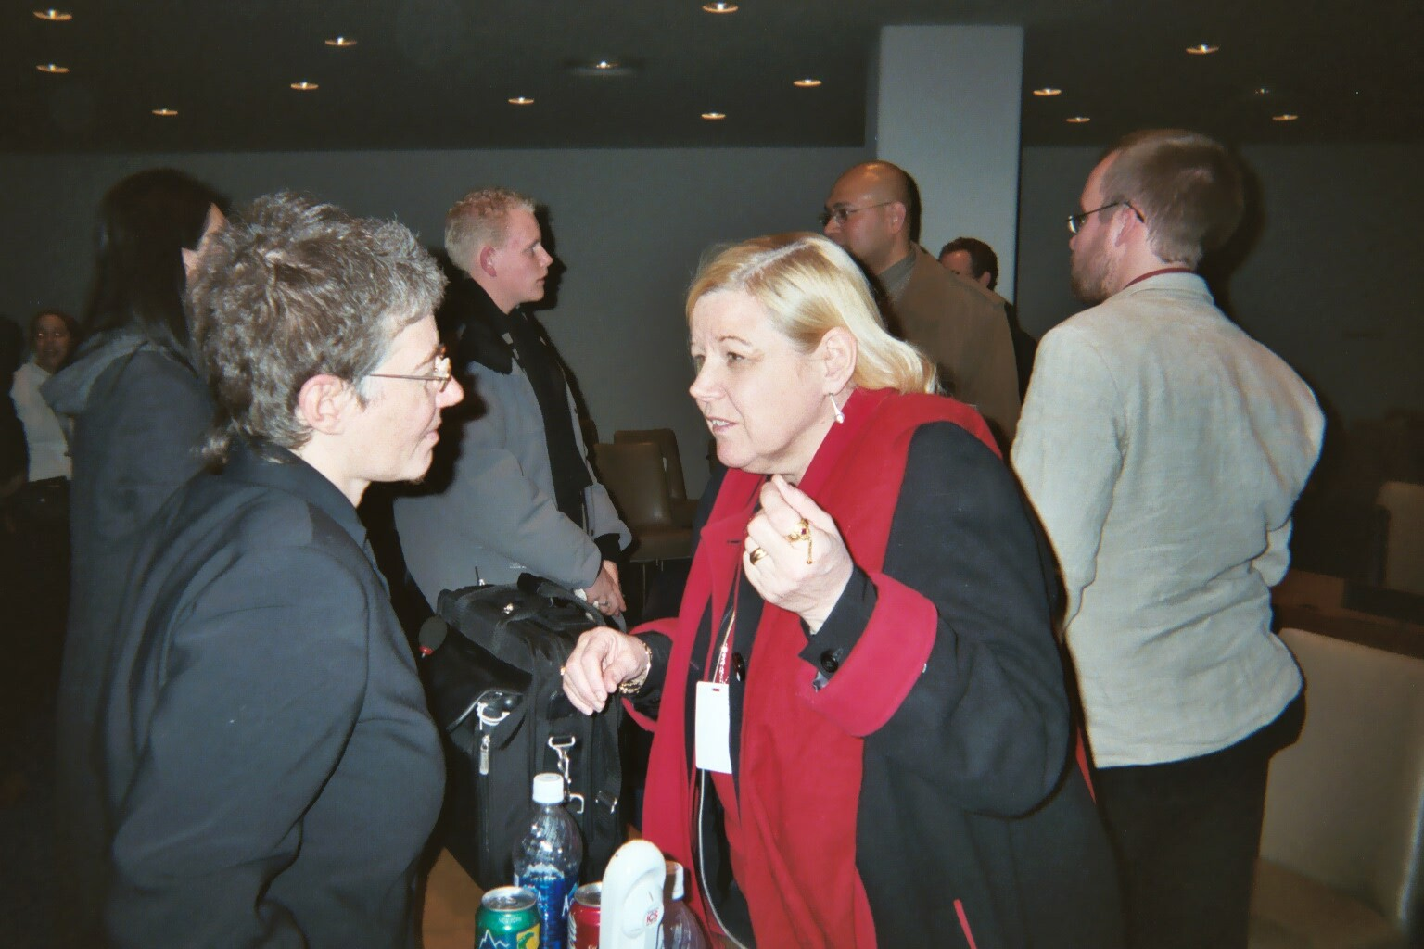

Slide 14
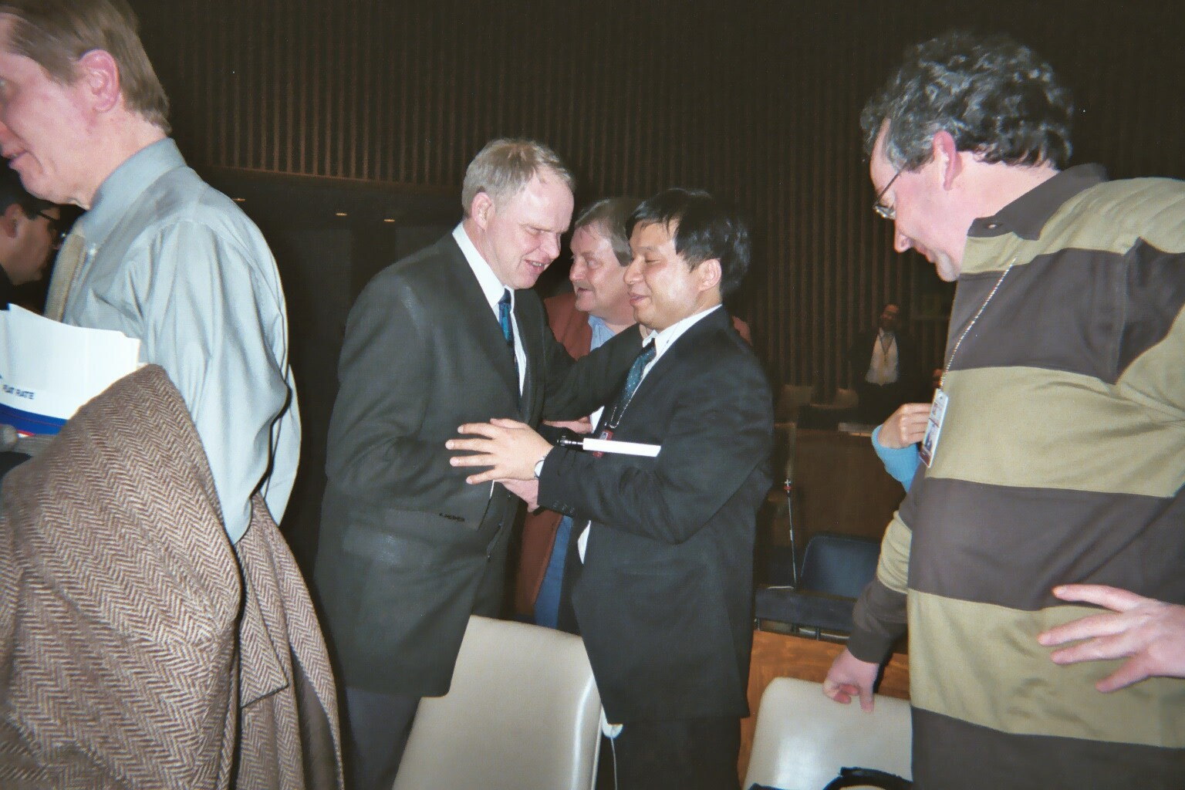

Slide 15
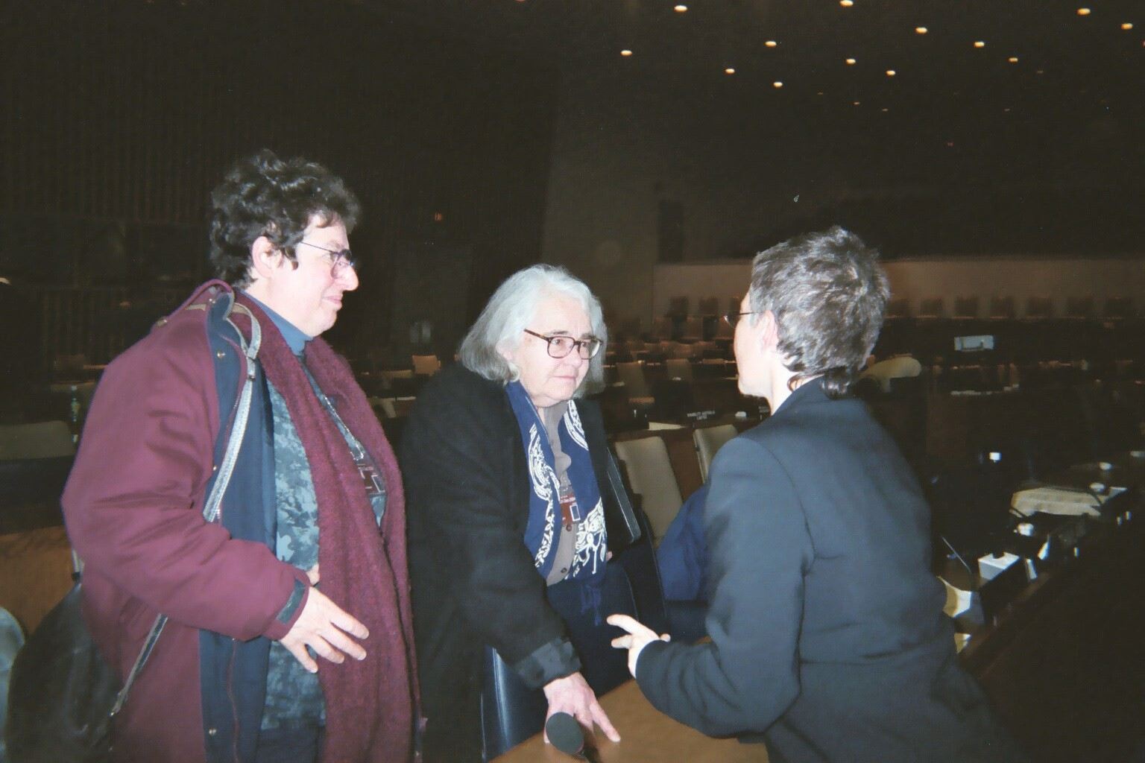

Slide 16
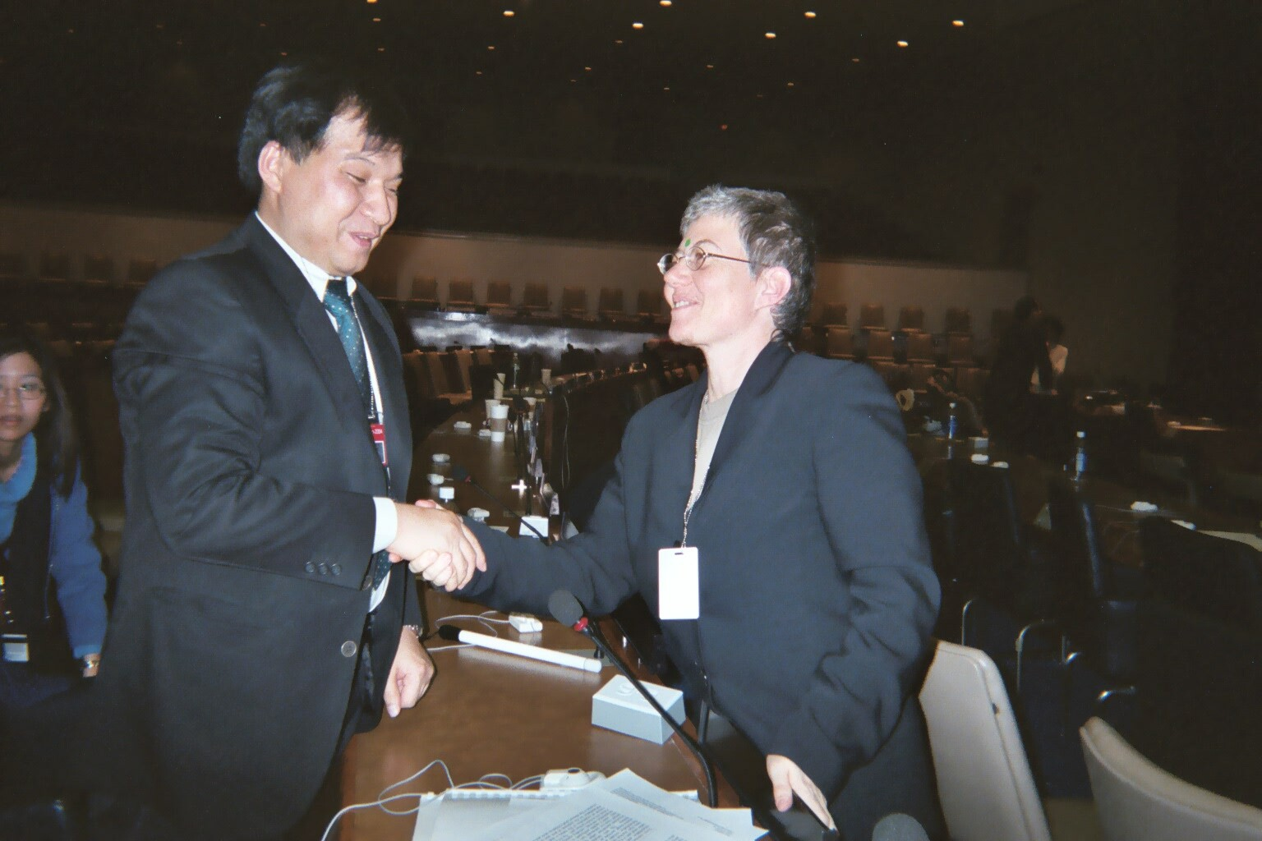

Slide 17
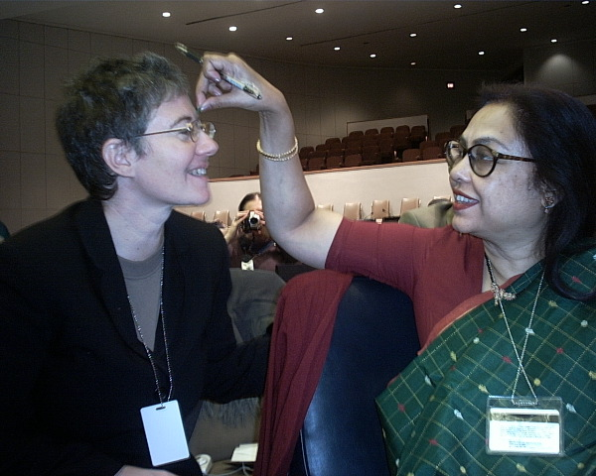

Slide 18
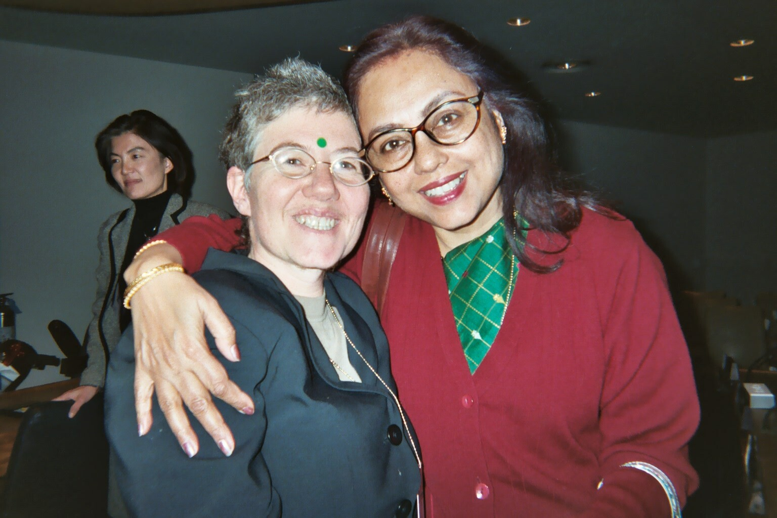

Slide 19
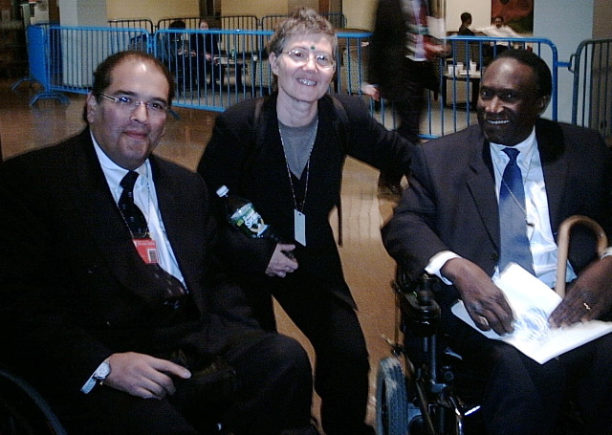

Slide 20
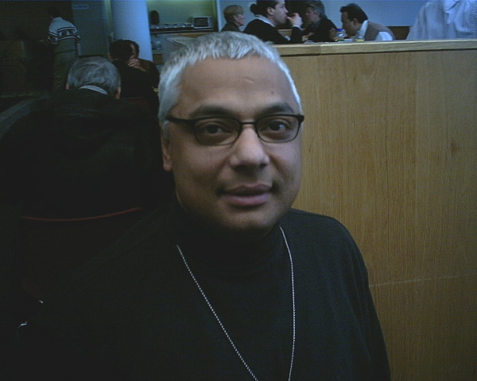

Slide 21
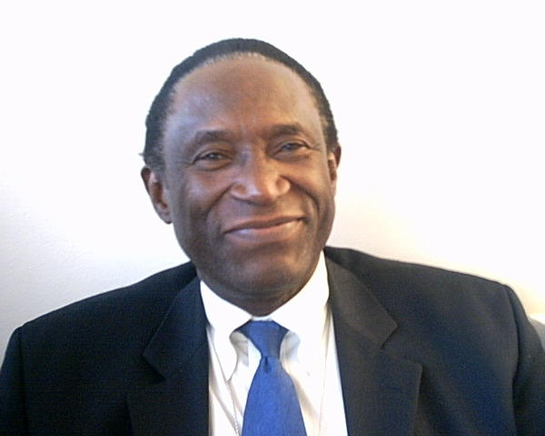

Slide 22
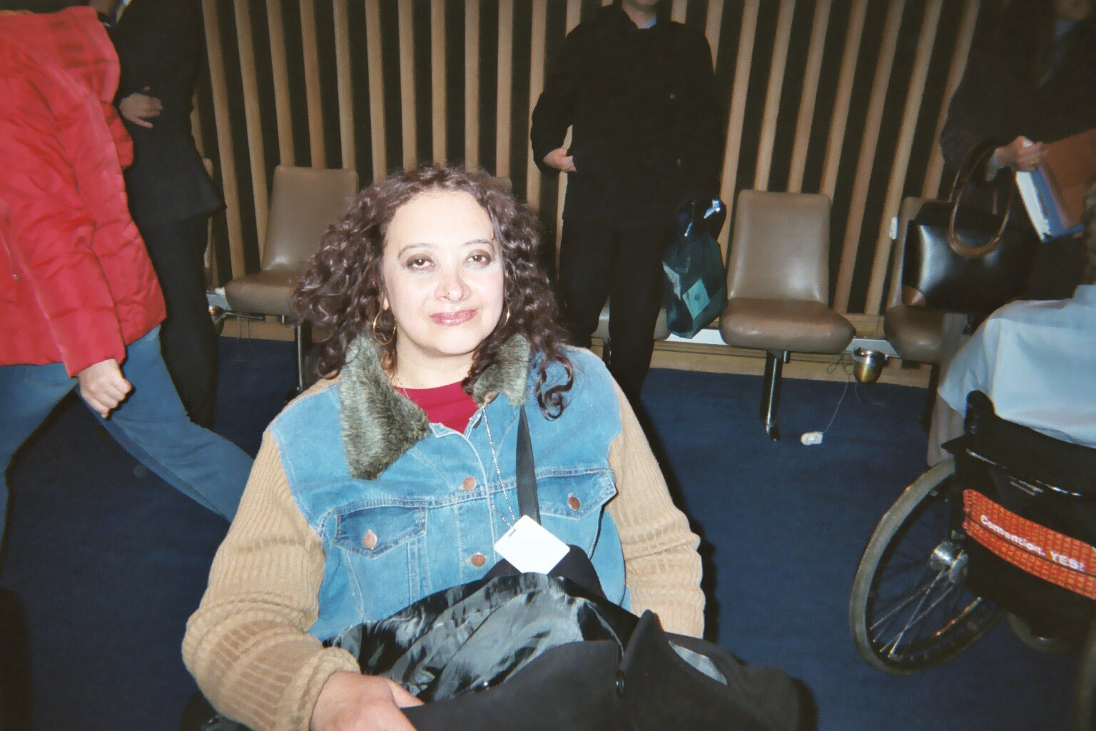

Slide 23
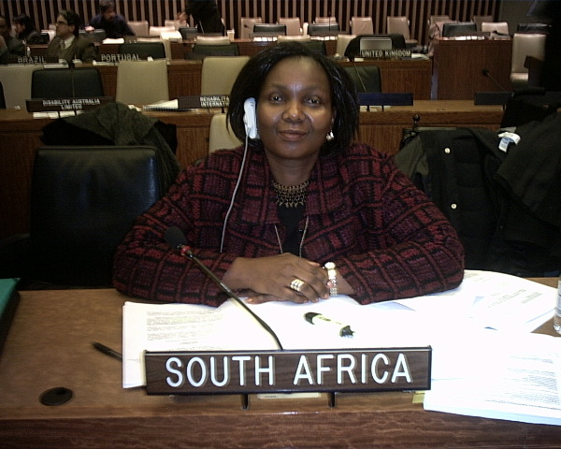

Slide 24
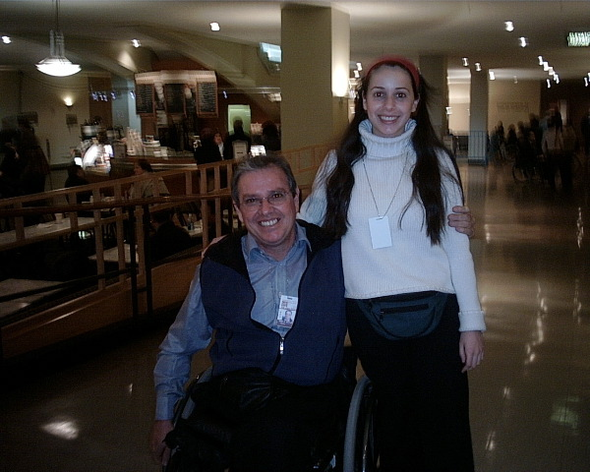

Slide 25
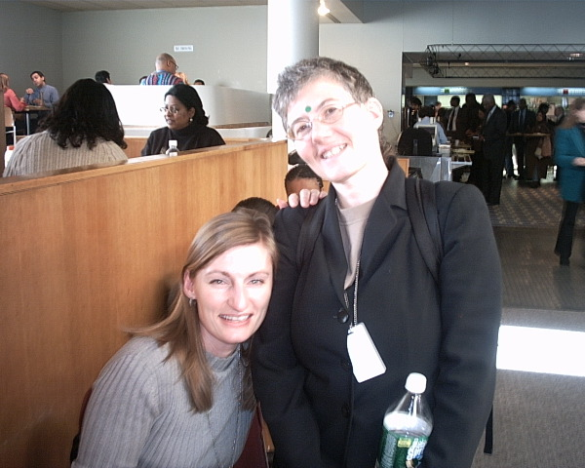

Slide 26
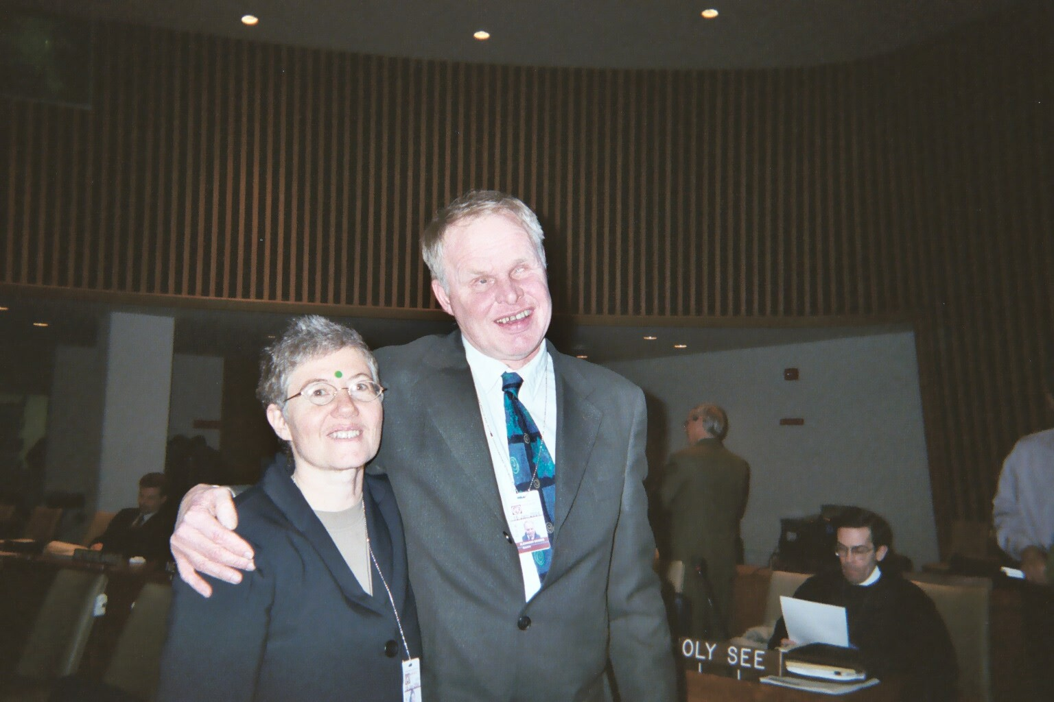

Slide 27
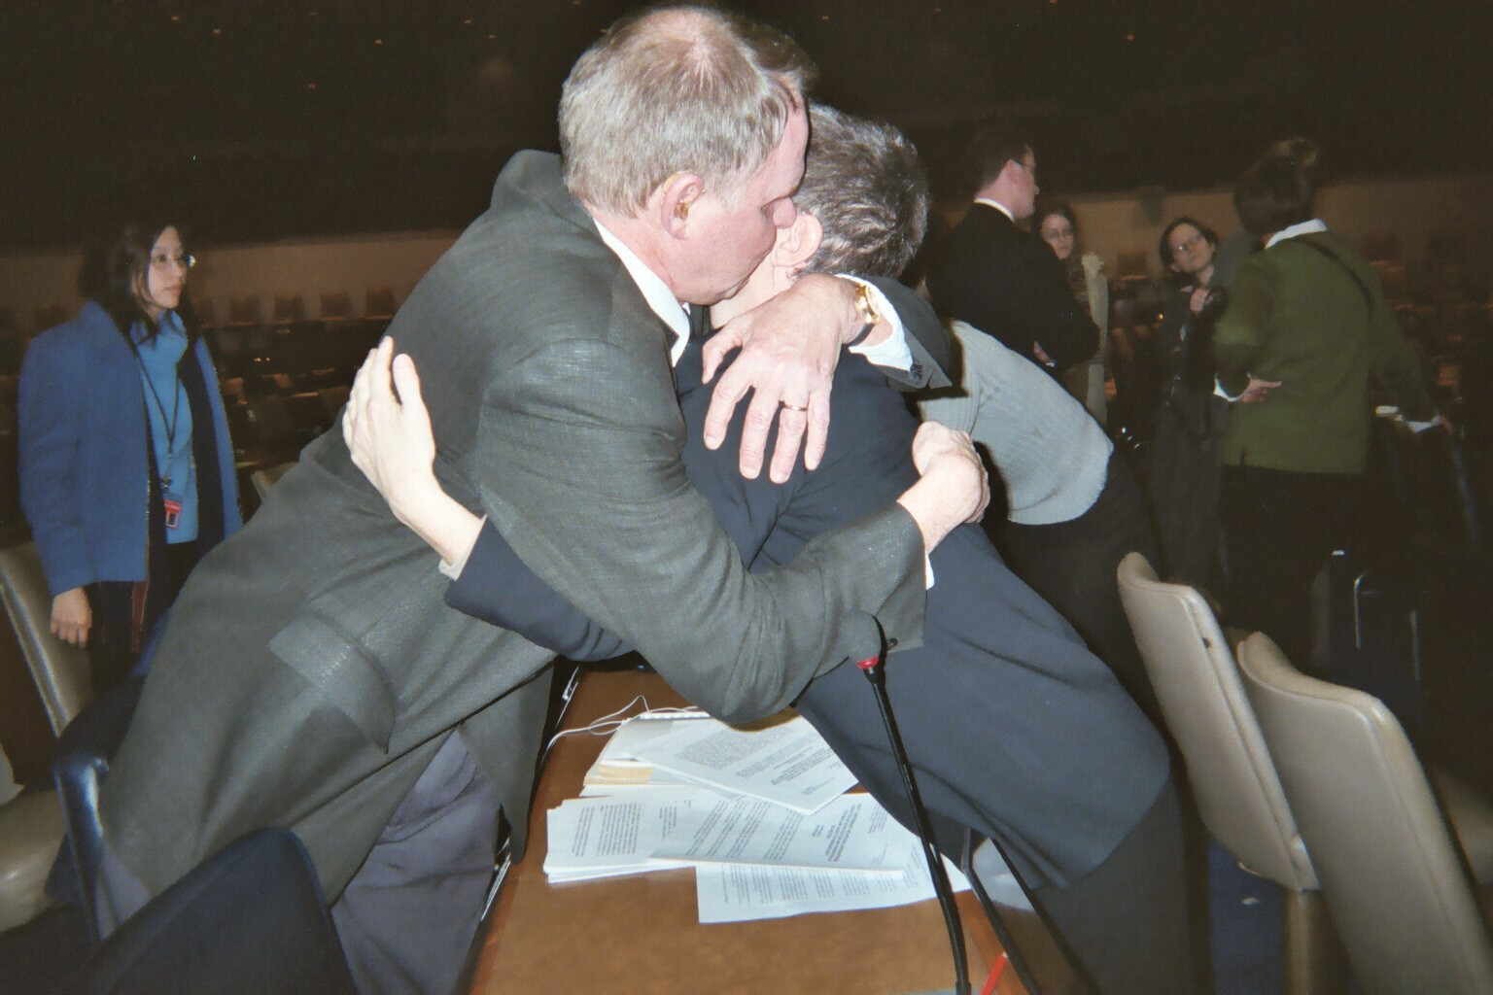

Slide 28
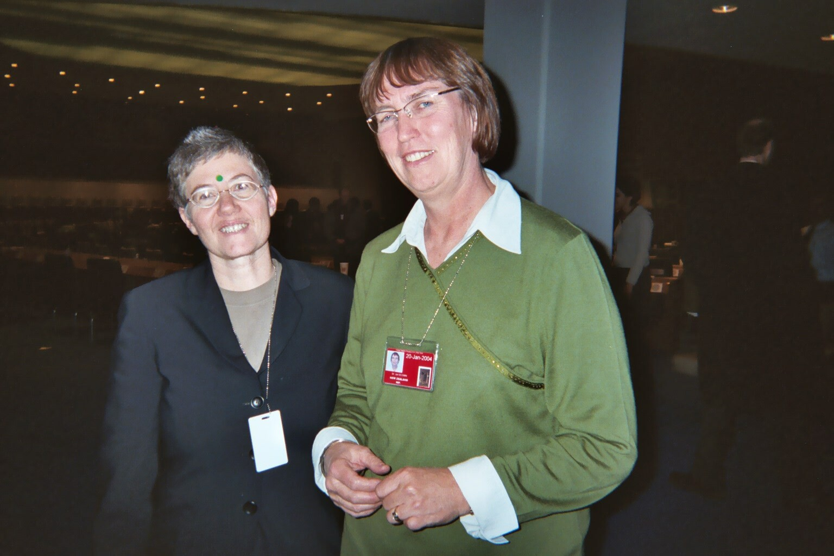

Slide 29
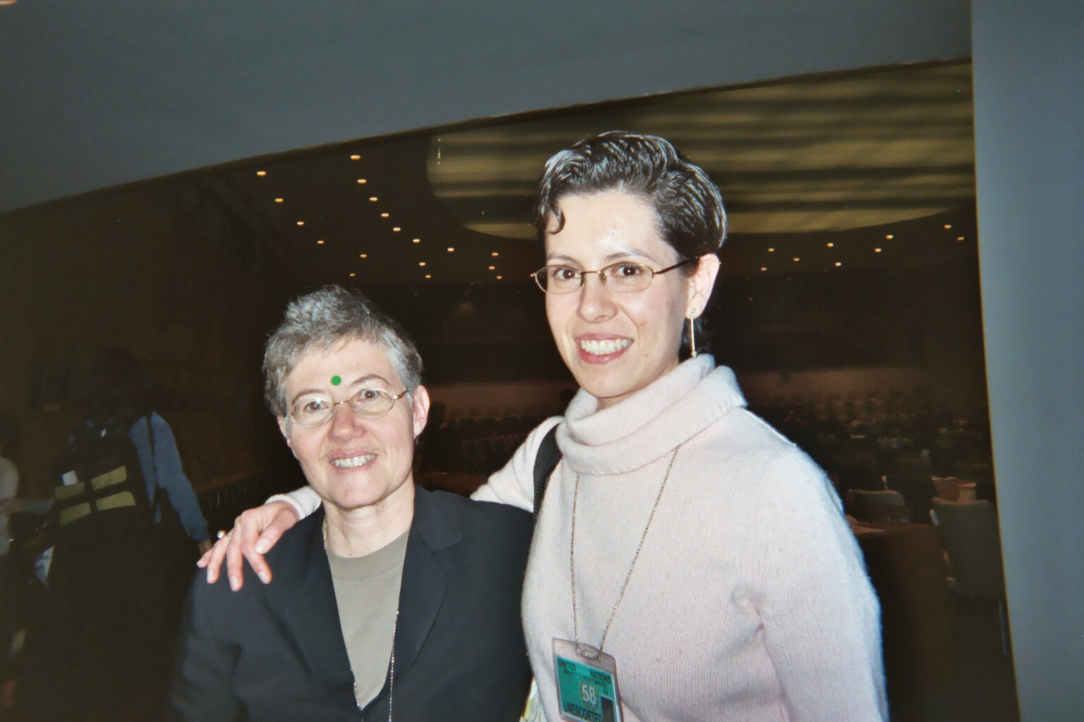

Slide 30
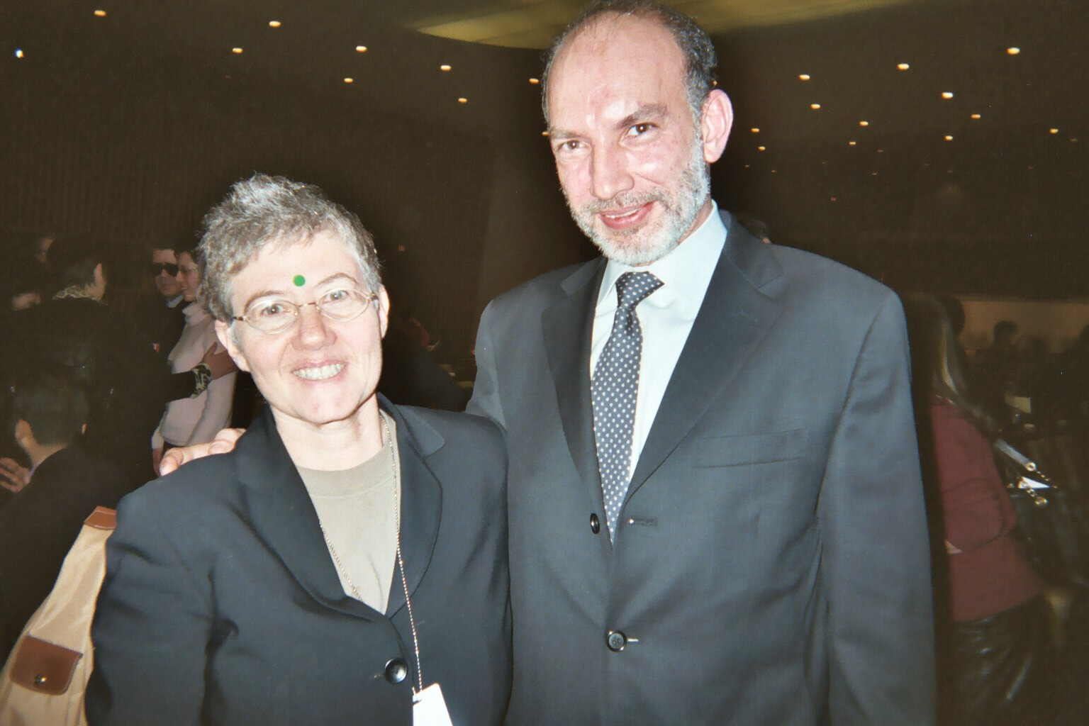

Slide 31
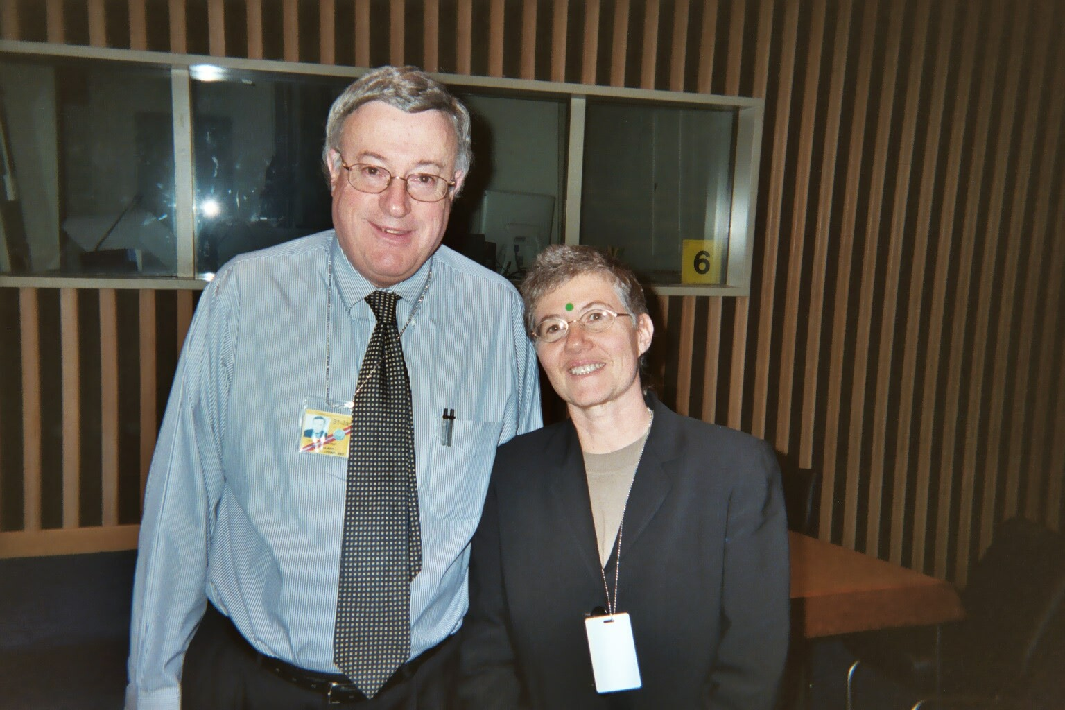

Slide 32
Translating into Human Rights
Principles in CRPD
  Non-discrimination
  Individual autonomy and freedom to make one’s own choices
  Acceptance of diversity
Holistic: every article is written in a way that we can find ourselves included

Slide 33
Translating Into Human Rights 2
No incarceration =
Right to liberty without discrimination, no deprivation of liberty based on disability (Art 14)
No forced intervention =
Forced intervention to correct a disability is torture – Free and informed consent – Respect for physical and mental integrity
(Arts 15, 17 and 25)
  No exceptions
  Torture standard not in CRPD text but adopted by Special Rapporteur on Torture

Slide 34
Translating into Human Rights 3
Full legal rights with no discrimination =
Equal legal capacity to make decisions in all aspects of life – Obligation to abolish discriminatory laws – Right to vote, be a parent, etc., all articles “on an equal basis with others”/ “without discrimination based on disability”
(Art 2, 3, 4, 5, 12, etc.)

Slide 35
Translating into Human Rights 4
No contingent services =
Right to health, adequate standard of living, peer support and other services etc. – as human rights (Art 25, 26, 28 etc.)
  Support for legal capacity that respects the person’s will and preferences – Support to live in community and opportunity to choose where and with whom to live – Right to privacy – Etc.
  (Art 12, 19, 22)

Slide 36
How Did We Do?
1) We speak for ourselves and reject anybody else's attempt to speak for us. ✔
2) The MI principles have to be overruled. ✔
3) Psychiatric disability should not be singled out. ✔
4) Our core issues are no incarceration, no forced intervention in the name of treatment, full legal and human rights with no discrimination, no contingent services. ✔

Slide 37
User/Survivor Participation
Over 25 people from every region of the world and 14 countries came to UN
Many others supported via email discussions
Mainly WNUSP, also MindFreedom and local/national organizations, government delegations
International Disability Caucus steering committee
Some contributed ideas and strategy, others personal stories, informal lobbying

Slide 38
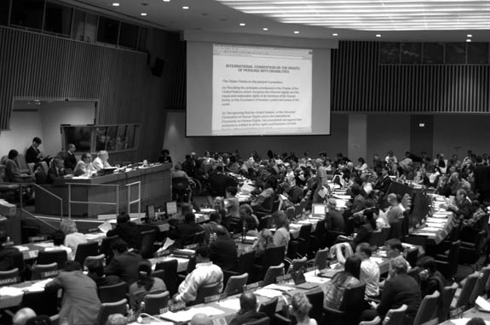
Photos by Tom Olin 8th Meeting

Slide 39
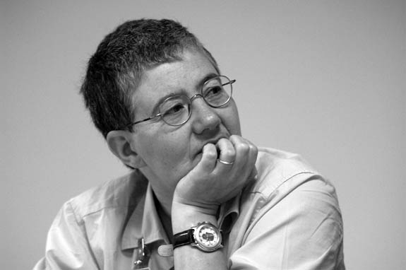

Slide 40
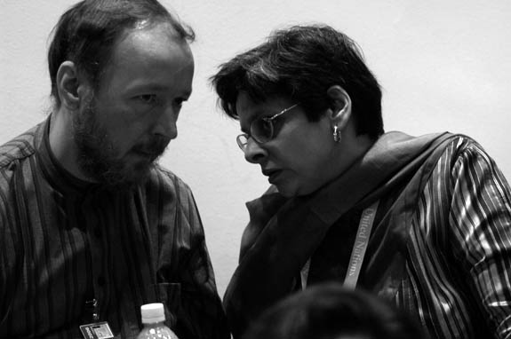

Slide 41
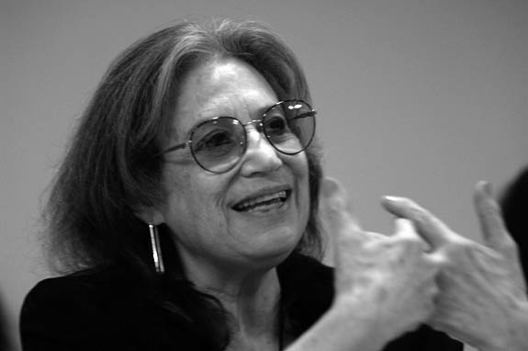

Slide 42
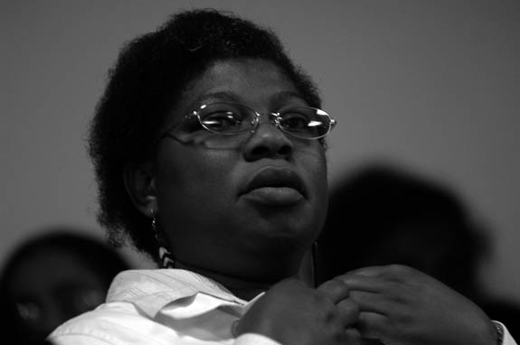

Slide 43
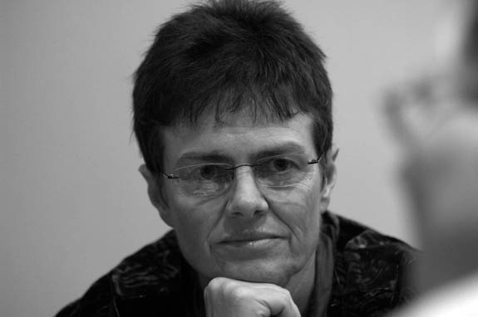

Slide 44
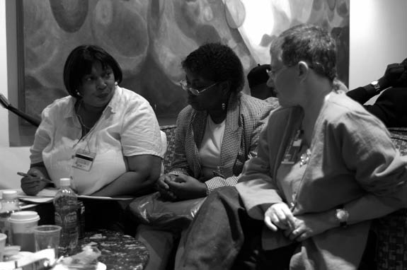

Slide 45
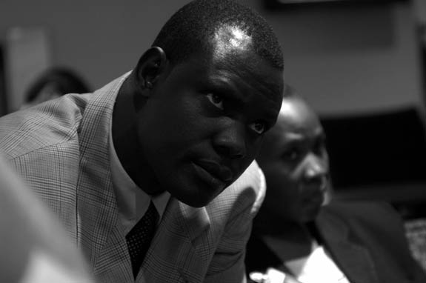

Slide 46
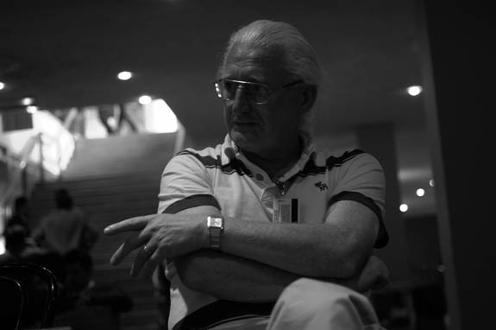

Slide 47
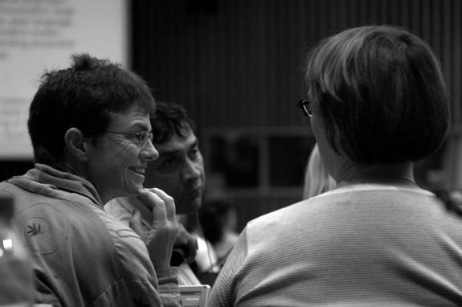

Slide 48
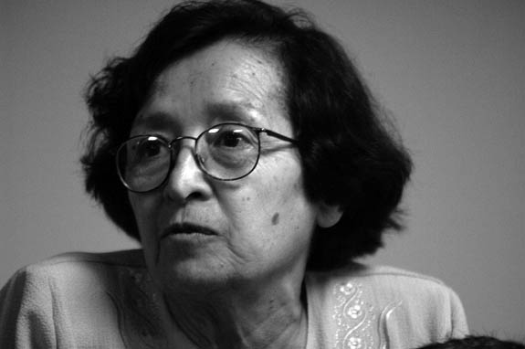

Slide 49
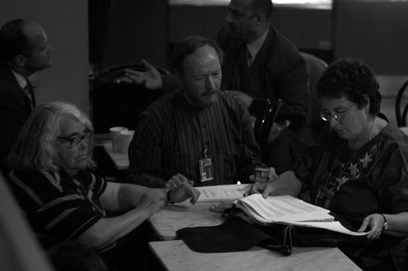

Slide 50
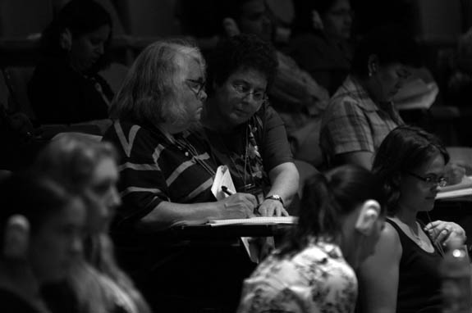

Slide 51
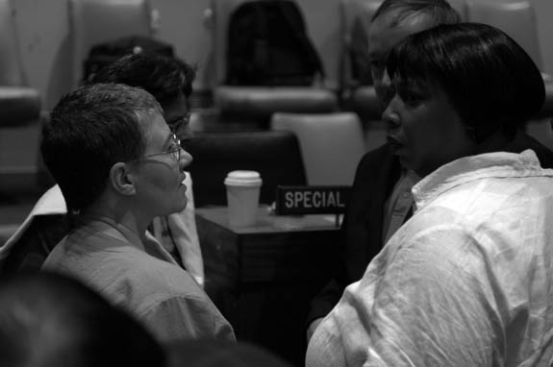

Slide 52
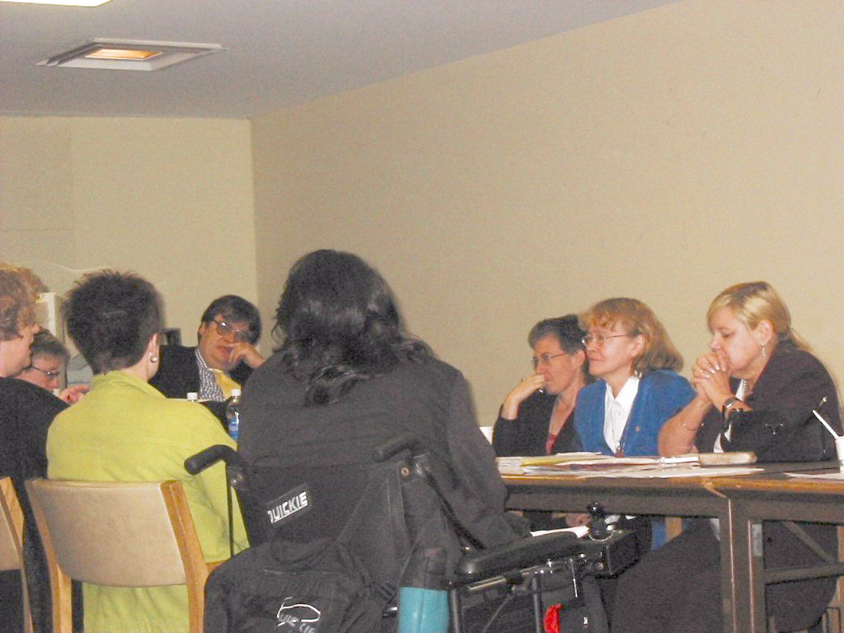

Slide 53
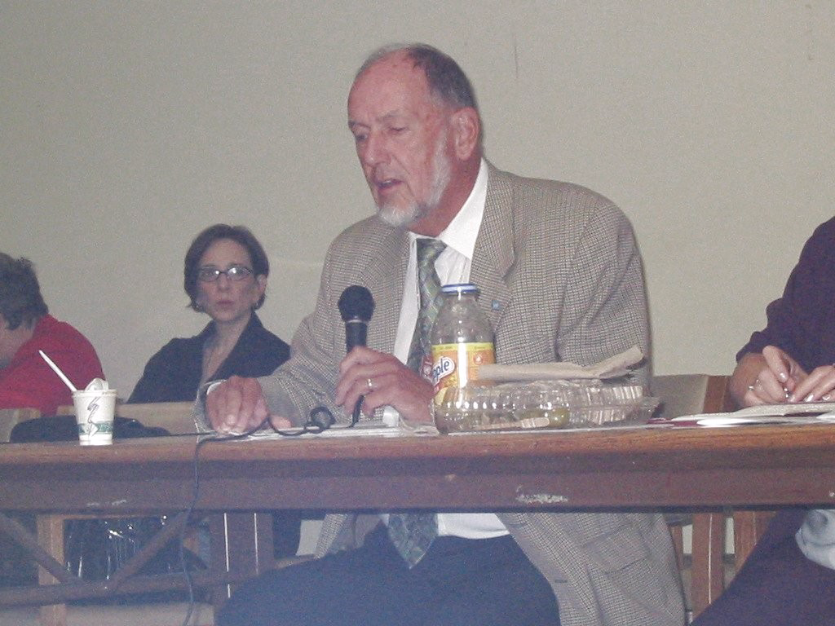

Slide 54
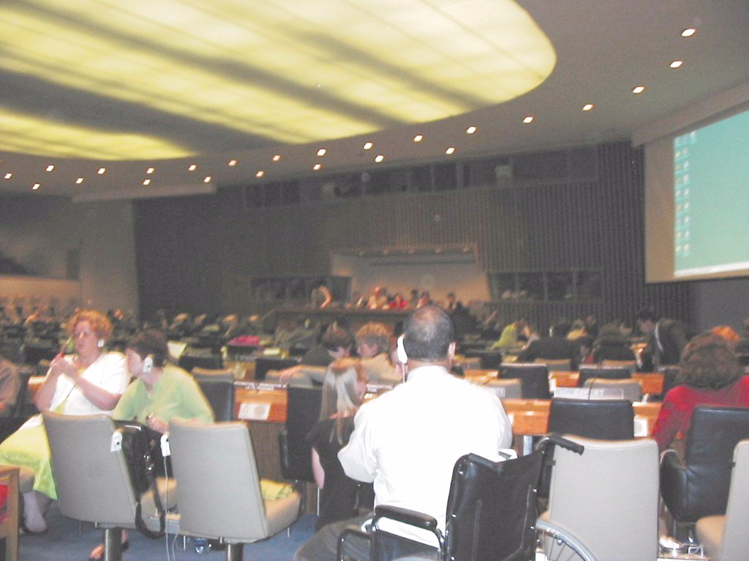

Slide 55
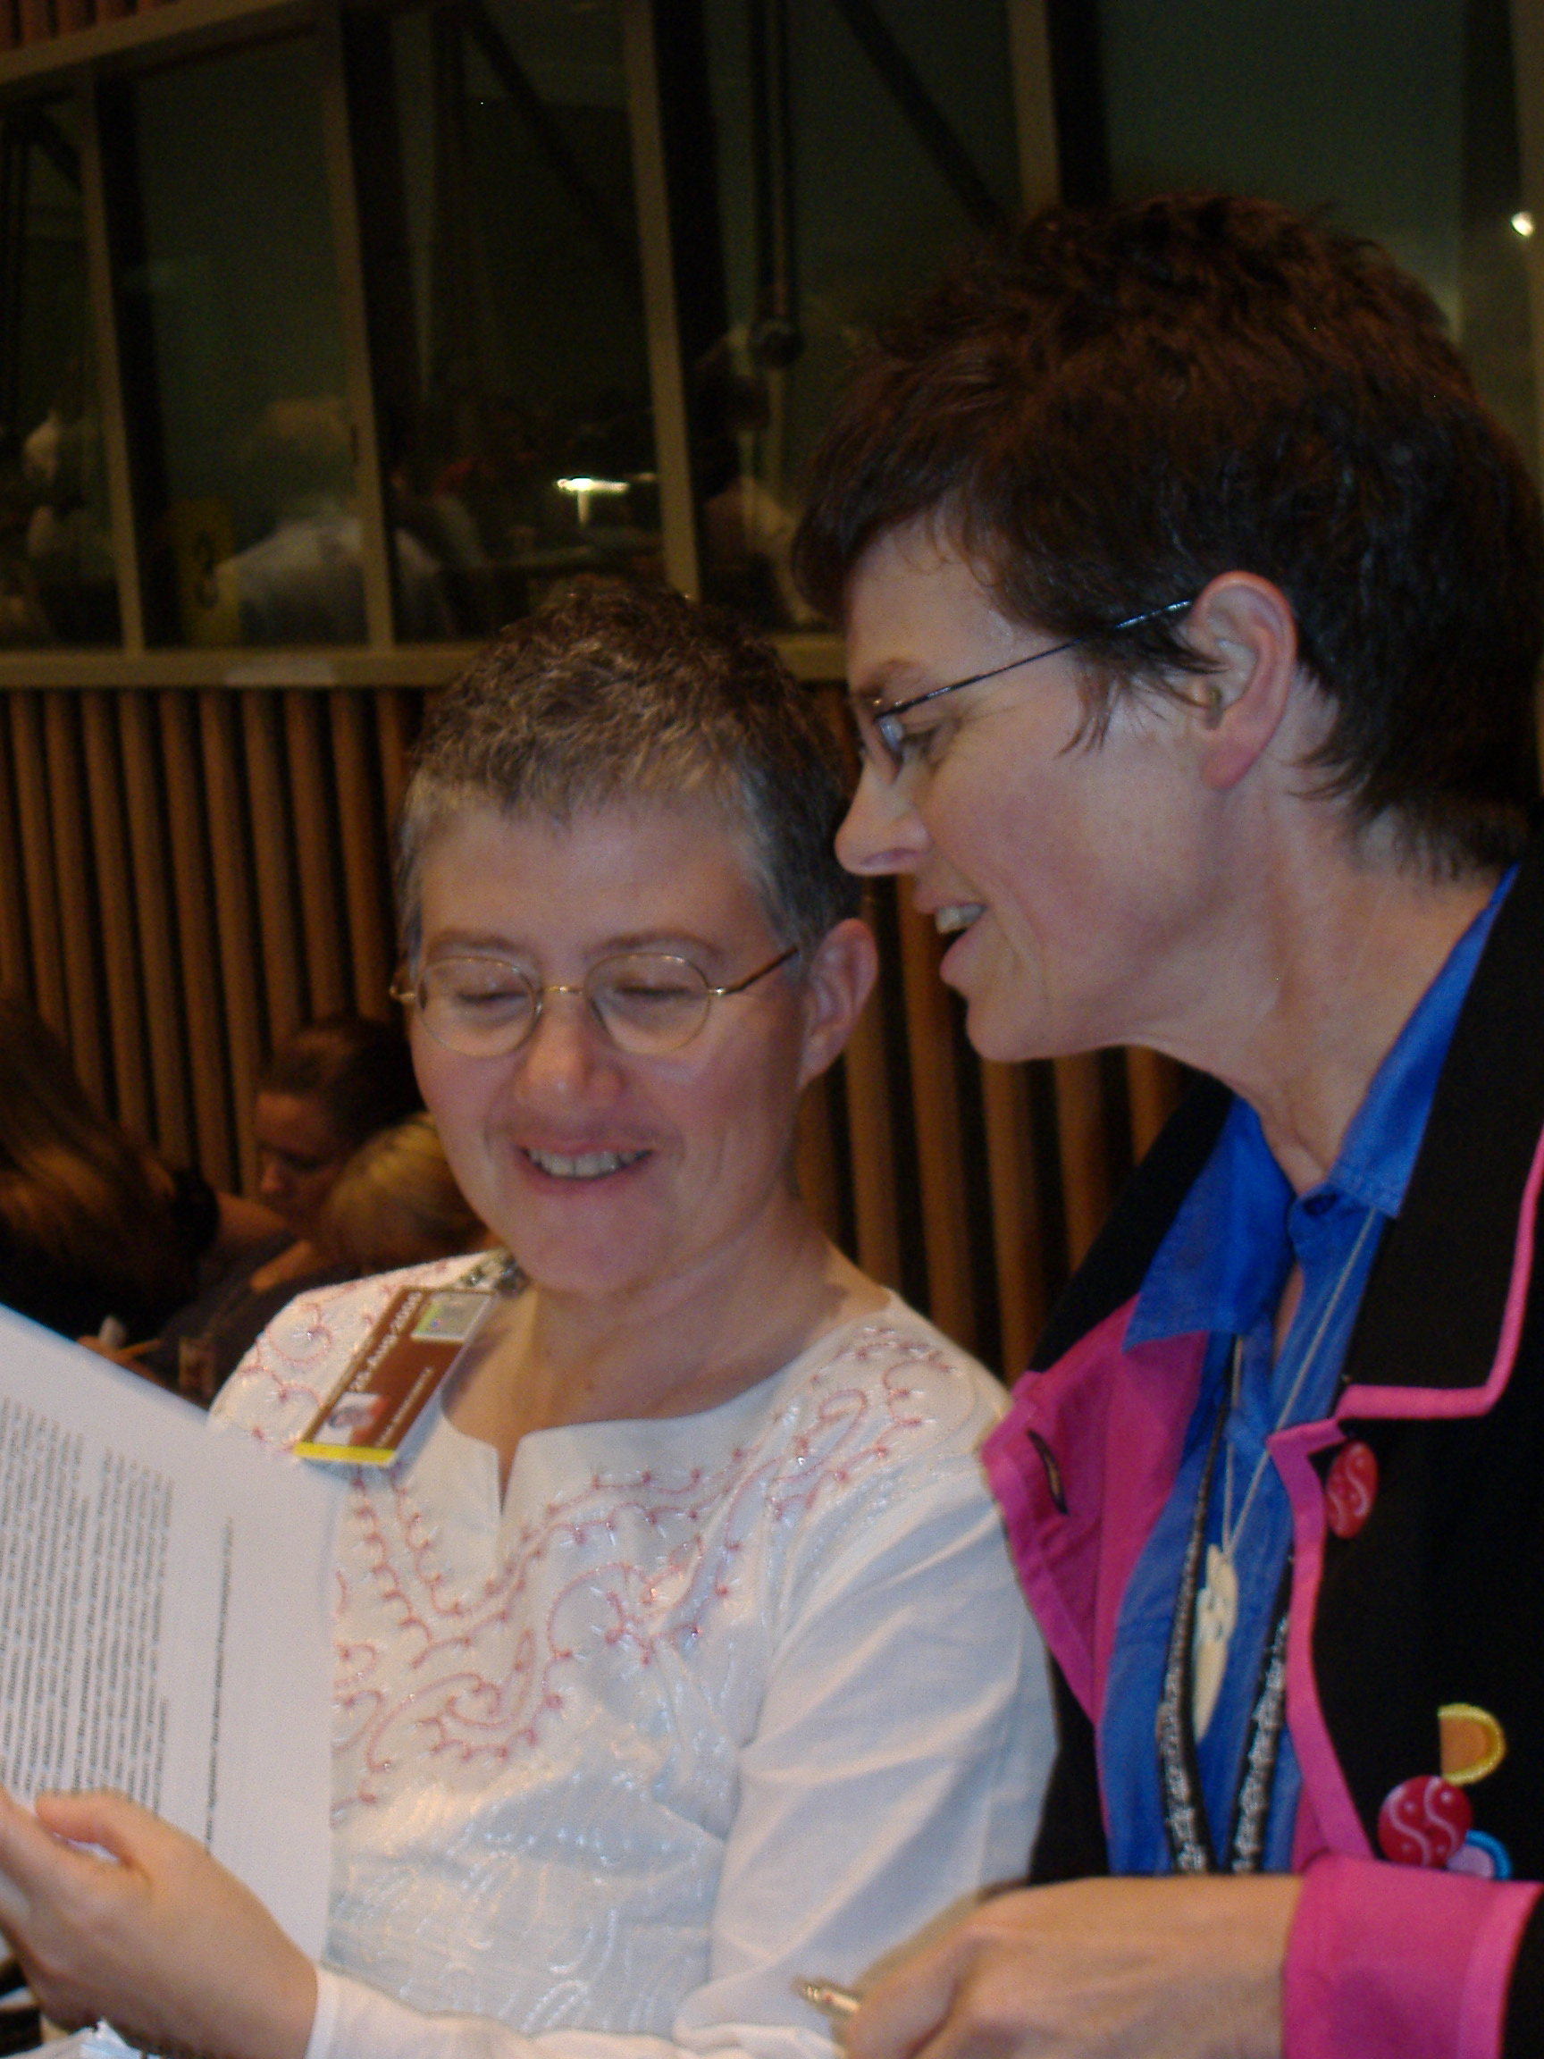

Slide 56
Disability Community
“Nothing About Us Without Us!”
WNUSP as member of IDA
IDC – International Disability Caucus – everyone welcome – PWD/DPO leadership – right to self-determination within disability community
Learning about each other and synthesizing – especially on legal capacity and respect for physical and mental integrity
Solidarity and respect – “Can the NGOs make a reservation?”

Slide 57
Challenges
As time went on, stake in outcome
From “we define our rights” to “we can taste it, we want it to come through”
Ignorance, hardball diplomacy, our own limitations
  Template for changes to services and support? Model policies?
  Newness, seat of the pants, unexpected
  Unfunded, no administrative support
  Ignoring the obvious
At the same time the weaknesses were strengths

Slide 58
“Fools Rush In”
Innocence…. Principle…. Persistence…. “On a mission”
We had nothing to lose – Opening to be heard, “they never stopped us”
Unexpected support along the way
Being heard, using human rights language and concepts, non-discrimination
Using our own stories judiciously, letting them know us as human beings – including passion and anger
Playing our own hardball when necessary
  “Convention NO – if it is a bad convention”

Slide 59
“Fools Rush In” 2
Knowing when to stand our ground on principle and when to compromise on wording
  “Would this allow forced intervention/incarceration/deprivation of legal capacity and autonomy?”
  “Is there a legally sound interpretation that gives us what we want? If so, OK because human rights treaty has to be interpreted favorably to its purpose”
  “Not whether you love it, whether you can live with it”
Turning defeat into victory: removing the legal capacity footnote

Slide 60
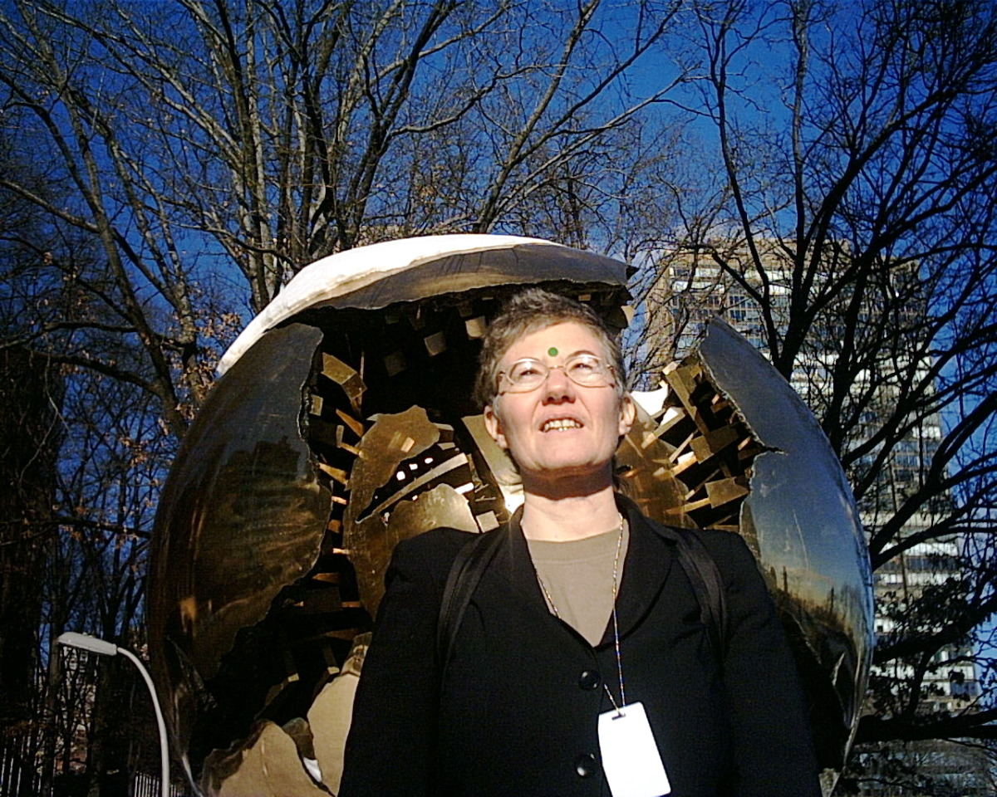
“when we tell the truth about our lives, the world splits open”

Slide 61
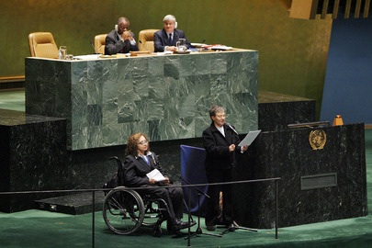
Speaking at Adoption Ceremony in General Assembly

Slide 62
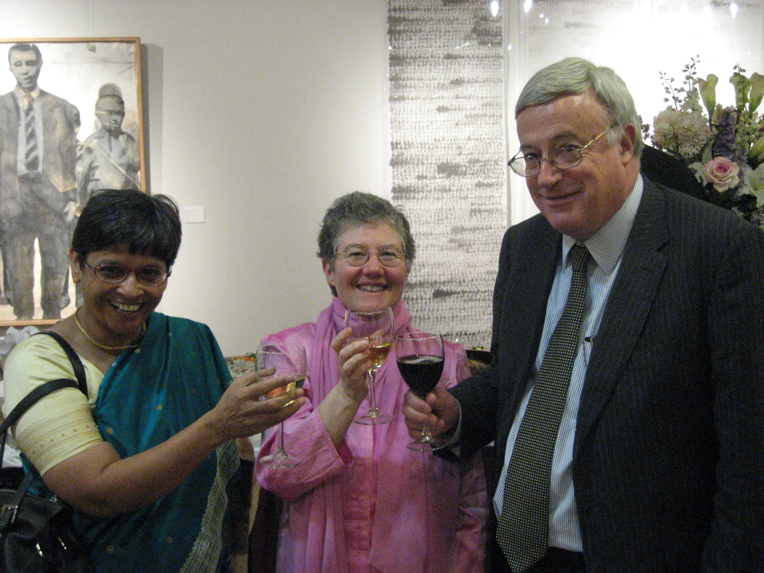
Celebrating Entry Into Force

Slide 63
Securing the Interpretation
UN Secretariat, “supersedes MI Principles”
Office of the High Commissioner for Human Rights guidance documents – Thematic Study – Info Note on Detention - others
  Psychiatric incarceration based on “danger to self or others” violates CRPD and UDHR
  Abolish guardianship and other substituted decision-making, ONLY support and not substitution
  Abolish insanity defense

Slide 64
Securing the Interpretation 2
Special Rapporteur on Torture
  Forced electroshock and forced psychiatric drugging “for treatment of a mental condition” can amount to torture and ill-treatment
  “Notwithstanding the ‘good intentions’ of health professionals”
  “Reasons based on discrimination”
  “Aimed at correcting or alleviating a disability”
  “Free and informed consent of the person concerned”

Slide 65
Securing the Interpretation 3
Committee on the Rights of Persons with Disabilities
  “Replace substituted decision-making regimes with supported decision-making, which respects the person’s autonomy, will and preferences”
  “Ensure that mental health services are based on free and informed consent of the person concerned”
  Forcible drugging with neuroleptics breaches obligations relating to torture/ill-treatment

Slide 66
Carrying it Forward
Center for the Human Rights of Users and Survivors of Psychiatry – established 2009
  U.S. – United Nations – International cooperation
  Securing the interpretation – Law reform – Human rights monitoring and enforcement – Human rights education – Extending the analysis (prison issues, rights of older persons)

Slide 67
CHRUSP mission and website
www.chrusp.org
  The Center for the Human Rights of Users and Survivors of Psychiatry (CHRUSP) provides strategic leadership in human rights advocacy, implementation and monitoring relevant to people experiencing madness, mental health problems or trauma.
  In particular, CHRUSP works for full legal capacity for all, an end to forced drugging, forced electroshock and psychiatric incarceration, and for support that respects individual integrity and free will.

Slide 68
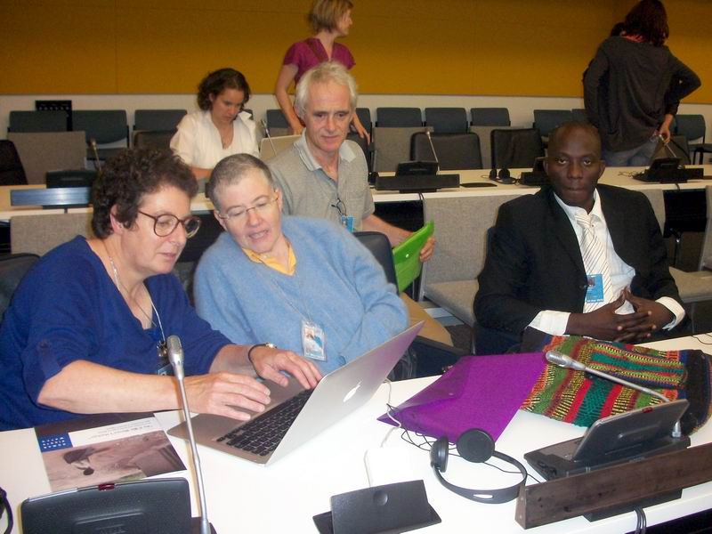
CRPD Conference of States Parties

Slide 69
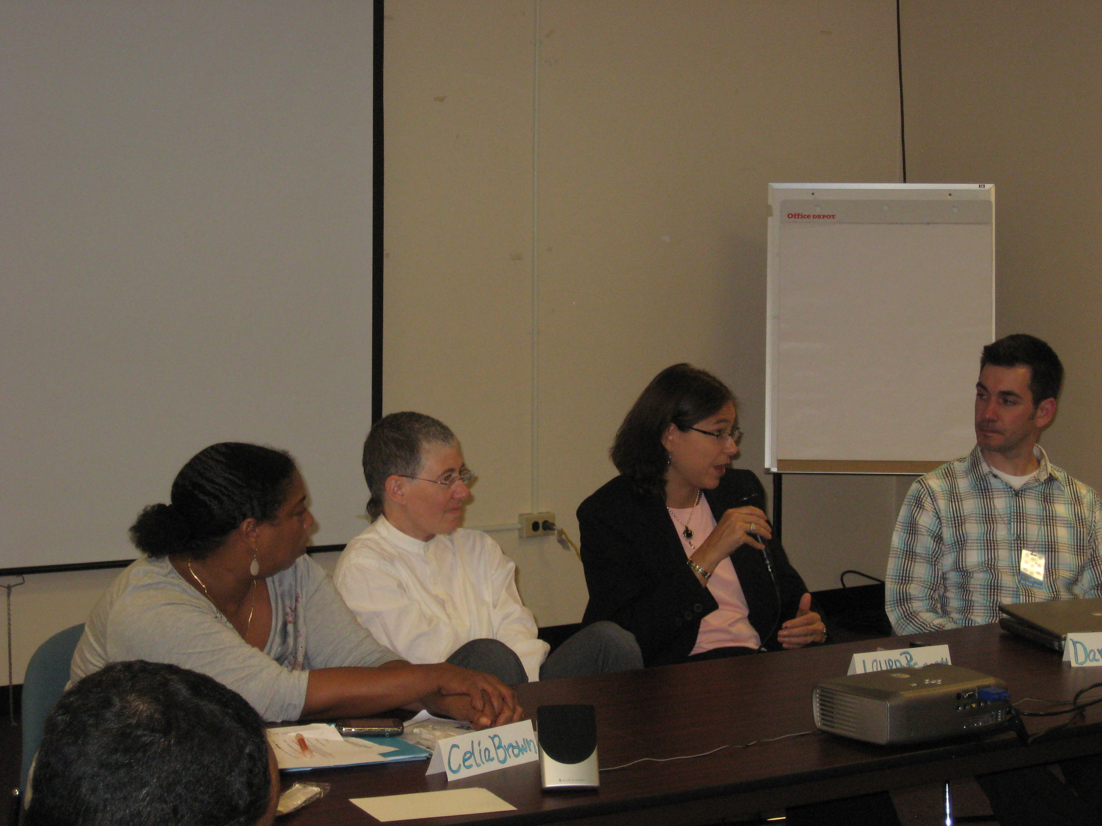
CHRUSP/WNUSP Side Event MH, Criminal Justice and Trauma

Slide 70
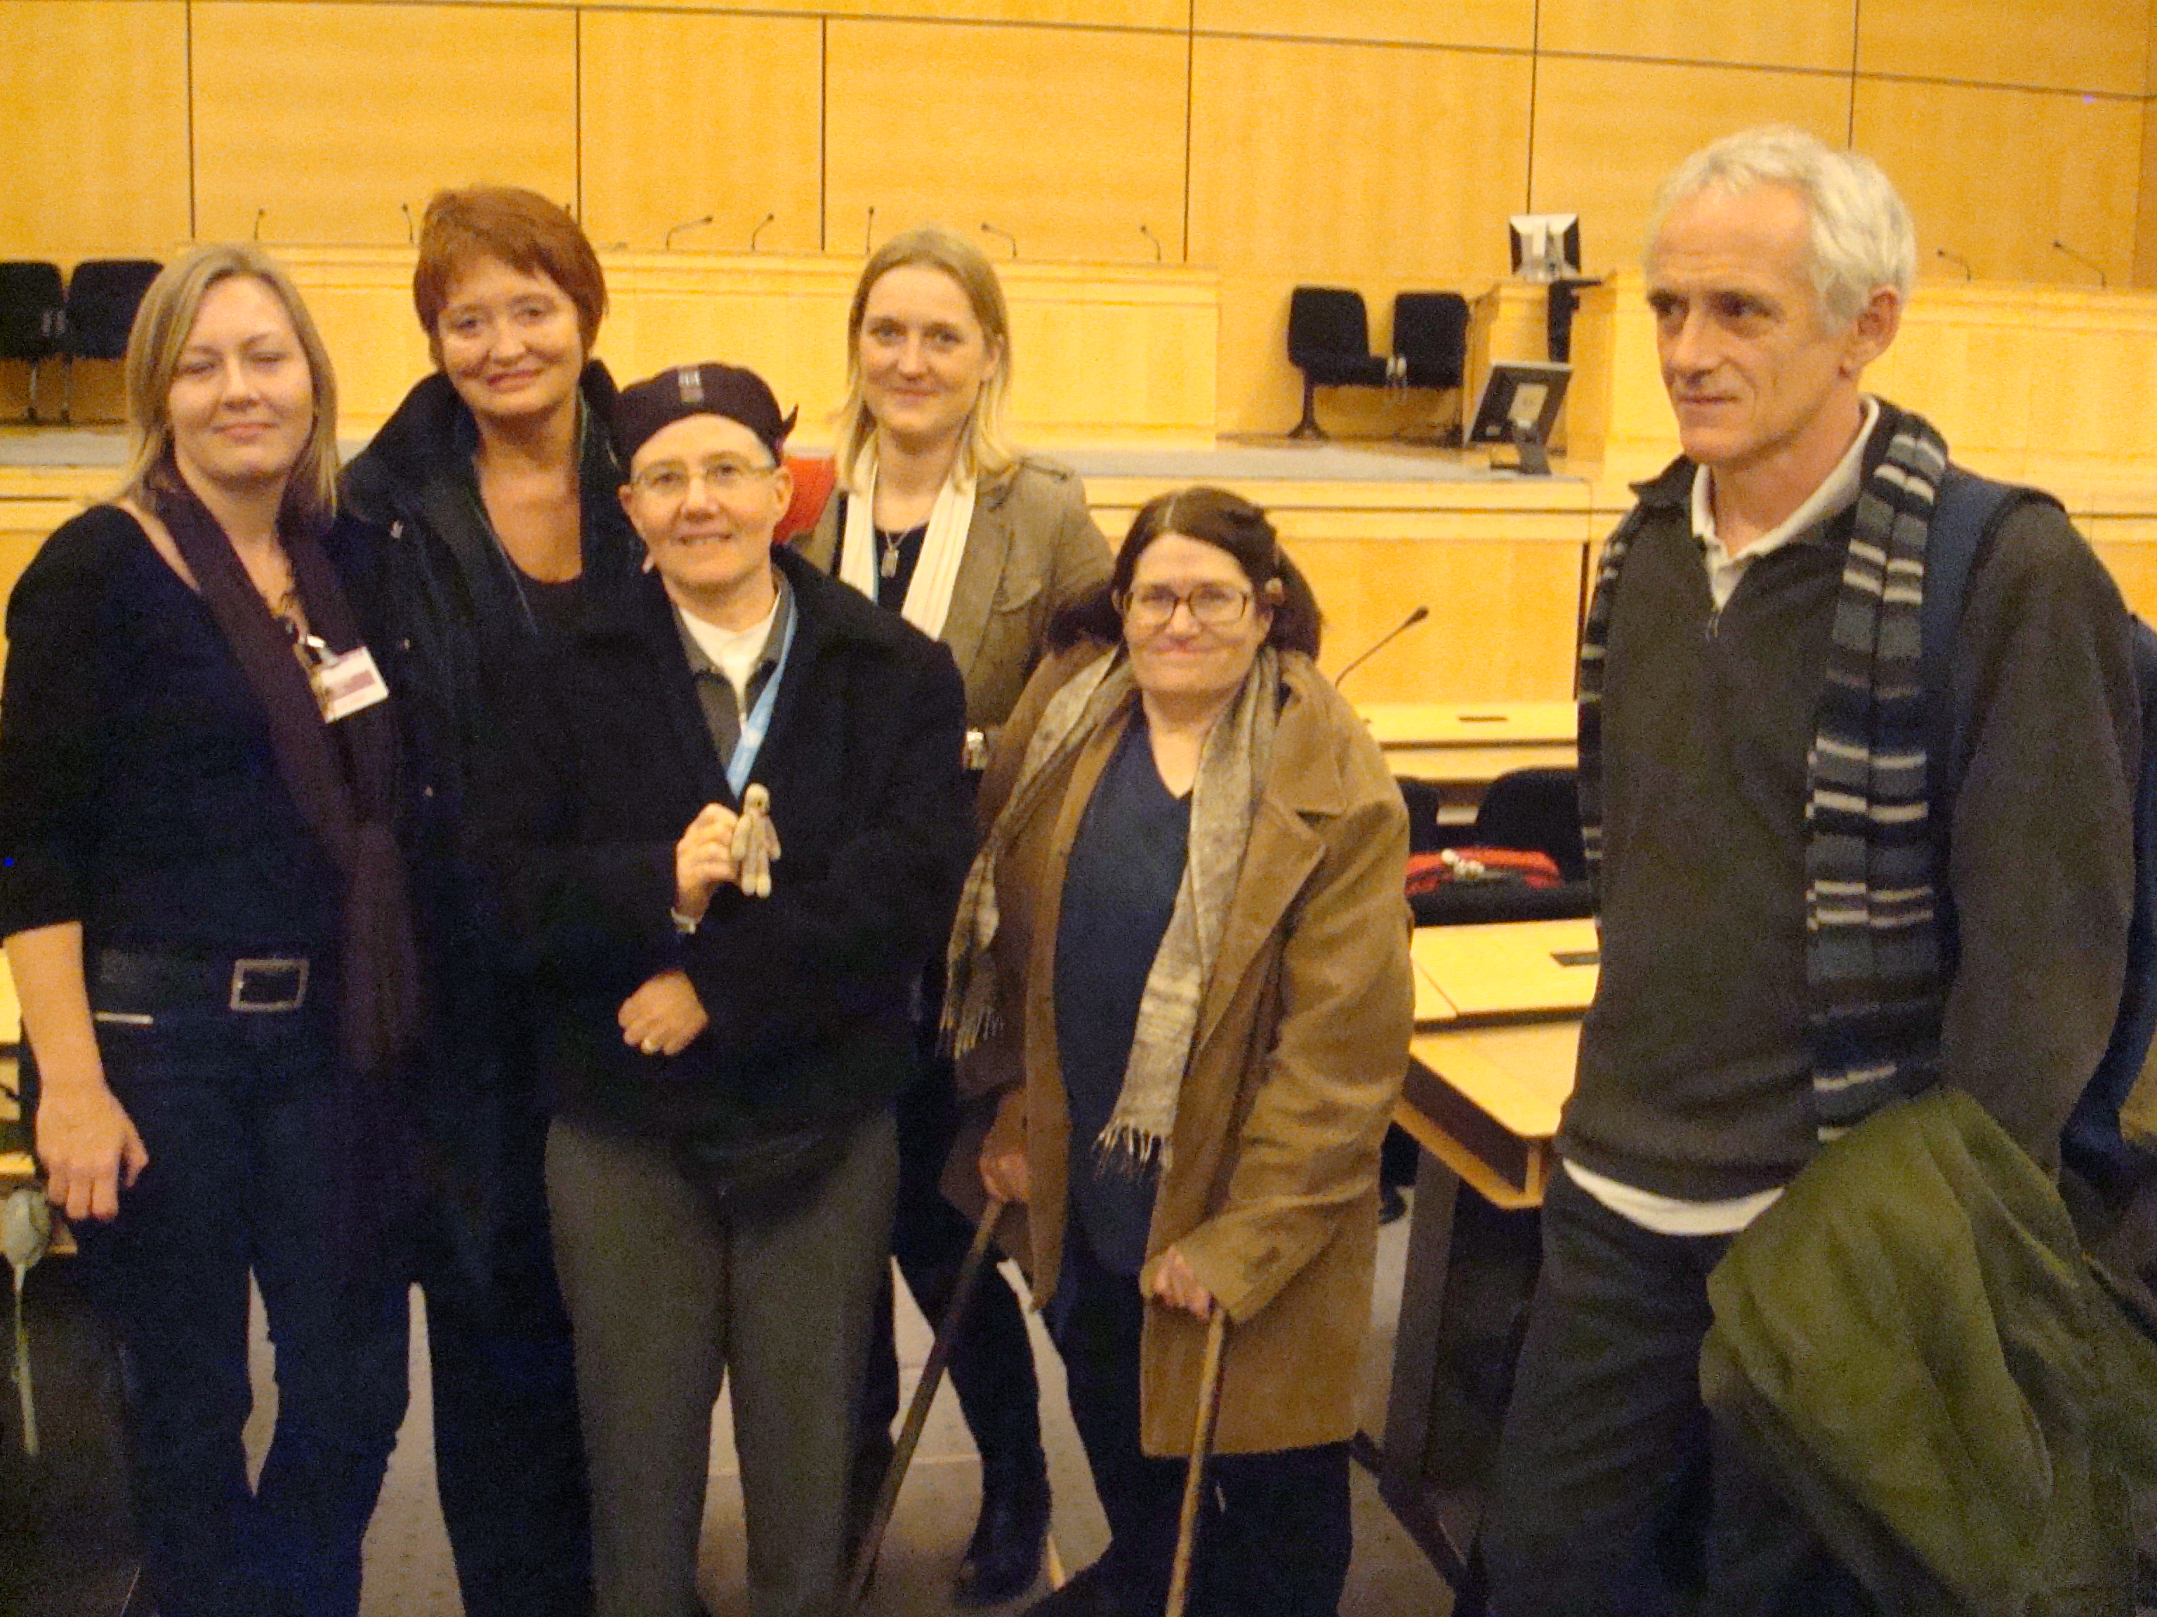
At UN Discussion on Legal Capacity

Slide 71
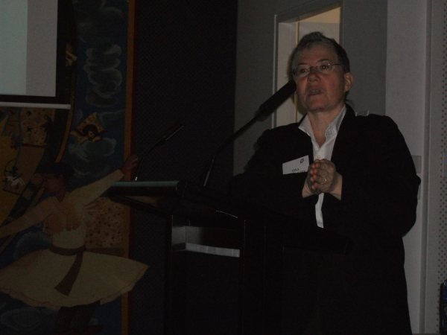
Speaking in Australia

Slide 72
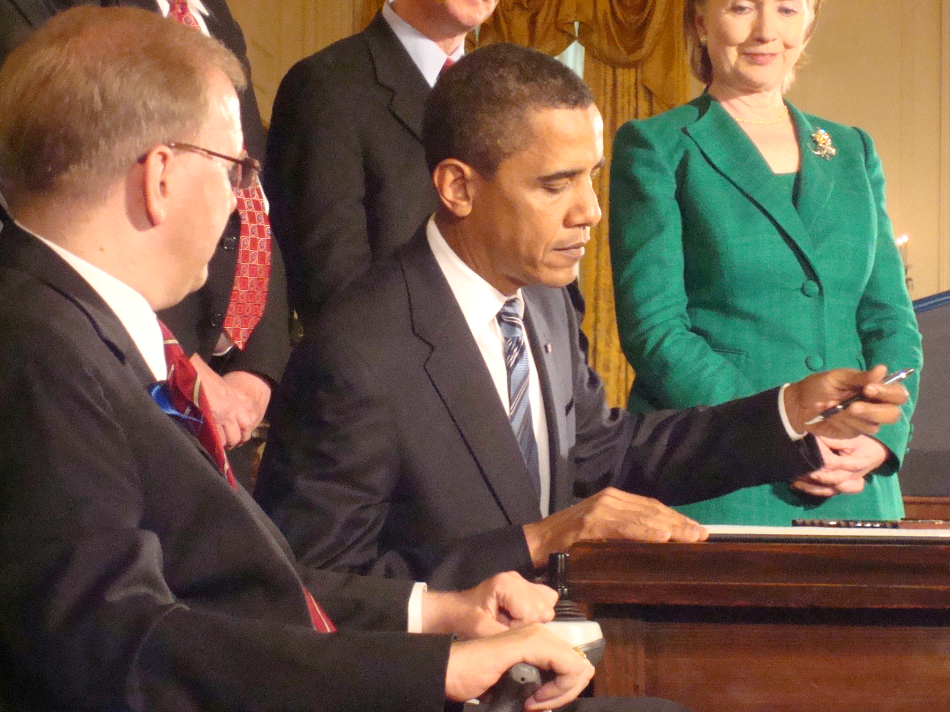
Obama Signing CRPD for U.S.

Slide 73
Next Steps
Campaign to Repeal Mental Health Laws
(laws that allow inpatient and outpatient commitment and forced interventions)
  Repeal by state legislature
  Federal law prohibiting incarceration/forced interventions
  Constitutional/ADA lawsuits
  http://repealmentalhealthlaws.org

Slide 74
Next Steps 2
Law reform – legal capacity
  Includes right to make decisions about mental health services, and repeal of MH laws
  Also, abolition of guardianship, representative payee etc.
  Repeal of other discriminatory laws
U.S. CRPD ratification, objecting to reservations, understandings and declarations

Slide 75
Next Steps 3
Shadow reporting – human rights monitoring
  Reinforces advocacy
  Bring reports to United Nations – ask Expert Committees or Special Rapporteur to issue recommendations
  International Covenant on Civil and Political Rights, Convention Against Torture, Convention on Elimination of All Forms of Racial Discrimination

Slide 76
Next Steps 4
Truth and Reconciliation/ Reparations Approach?
  All stakeholders to the table
  Acknowledge CRPD standards as basis – abolish incarceration, forced interventions, removal of decision-making capacity
  Commitment to full implementation
  Those who participated in forced practices disclose and make apology
  Victim-oriented, come forward and tell stories, assistance to rebuild lives

Slide 77
Become Involved!
Need strategic thinkers, lobbyists, organizers, demonstrations, story tellers, artists, etc.
Challenges now are different
Law reform/repeal is key – legal inferiority is both stigma and discrimination
We KNOW how to do alternatives
Legislators want to know: how many of you?
Determination – Dedication – Persuasion

Slide 78
Learn/Work with CHRUSP
Repealing Mental Health Laws
Shadow Reporting
Legal Capacity law/policy reform
Training calls (free)
Intensive training (can be tailored to your organization’s needs)
Study groups and extensive training – can be planned for future

Slide 79
For more information
www.chrusp.org
www.wnusp.net
www.un.org/disabilities
www.ohchr.org/EN/Issues/Disability/Pages/DisabilityIndex.aspx
repealmentalhealthlaws.org
Facebook CHRUSP and RMHL
tminkowitz@earthlink.net

